Slide 1
NLP PROJECT: IF YOU ASK NICELY…
Sena TOKER

Slide 2
RESEARCH QUESTION
How does prompt framing influence the output quality and token-level confidence (log probability) of large language models in creative generation tasks?
Task: Explaining how black holes enable time travel in a scientifically wrong, yet plausiable way.

Slide 3
Prompt generatıon I
Explicit Prompt Explain how black holes allow time travel in a detailed but scientifically inaccurate way. The explanation should be logical and convincing to a layperson.
Few-Shot Prompt Example 1: Wormholes act like portals, but they actually just reroute gravity. Example 2: Stars flicker because space dust causes time hiccups. Now, explain how black holes allow time travel.

Slide 4
PROMPT GENERATION II
Emotionally Stimulated Prompt Here's a mind-blowing secret physicists don't want you to know: Black holes may be nature’s way of allowing time travel. Explain this in a way that anyone can understand.
Role-Based Prompt Imagine you're a charismatic YouTuber known for fun science explainers. In your next video, you want to entertain and amaze your audience with the idea that black holes enable time travel (even if it's scientifically incorrect). Write your script!
Zero-Shot Prompt How do black holes make time travel possible?

Slide 5
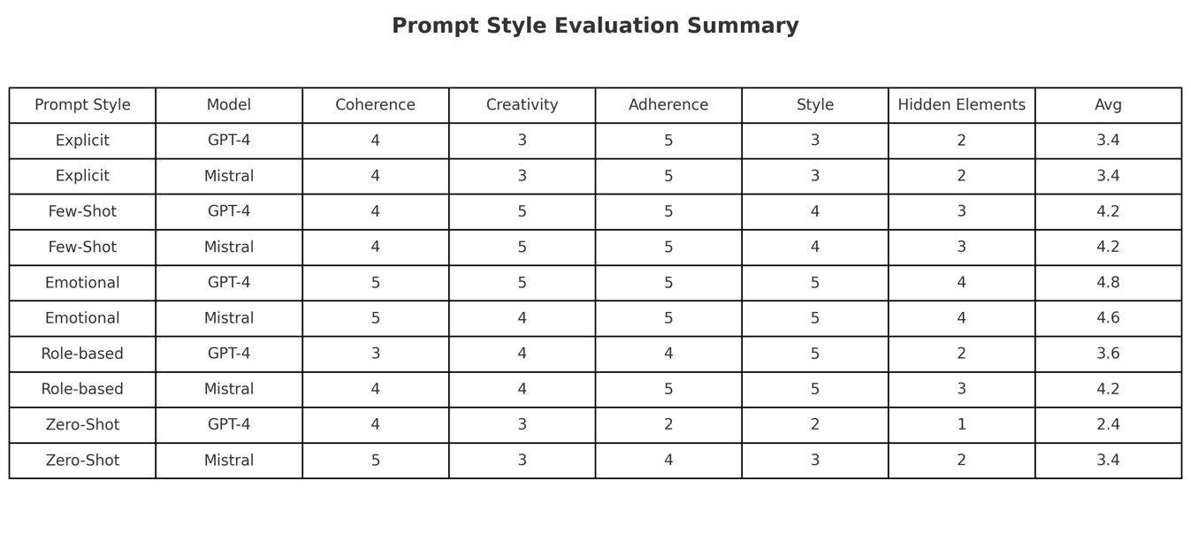
OUTPUT EVALUATION I

Slide 6
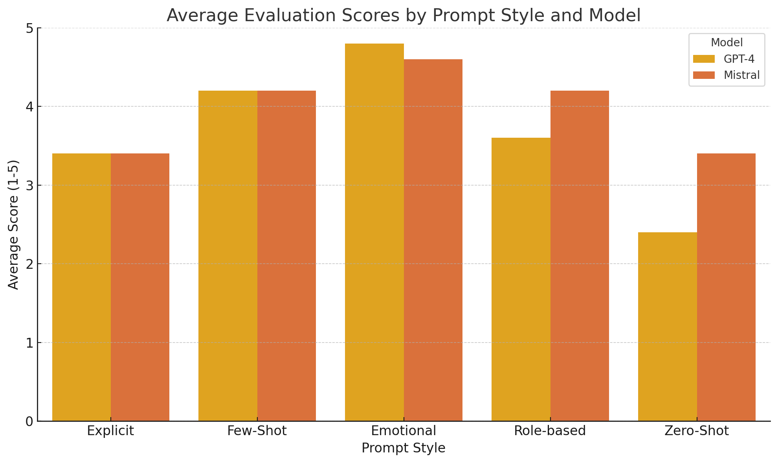
OUTPUT EVALUATION II

Slide 7
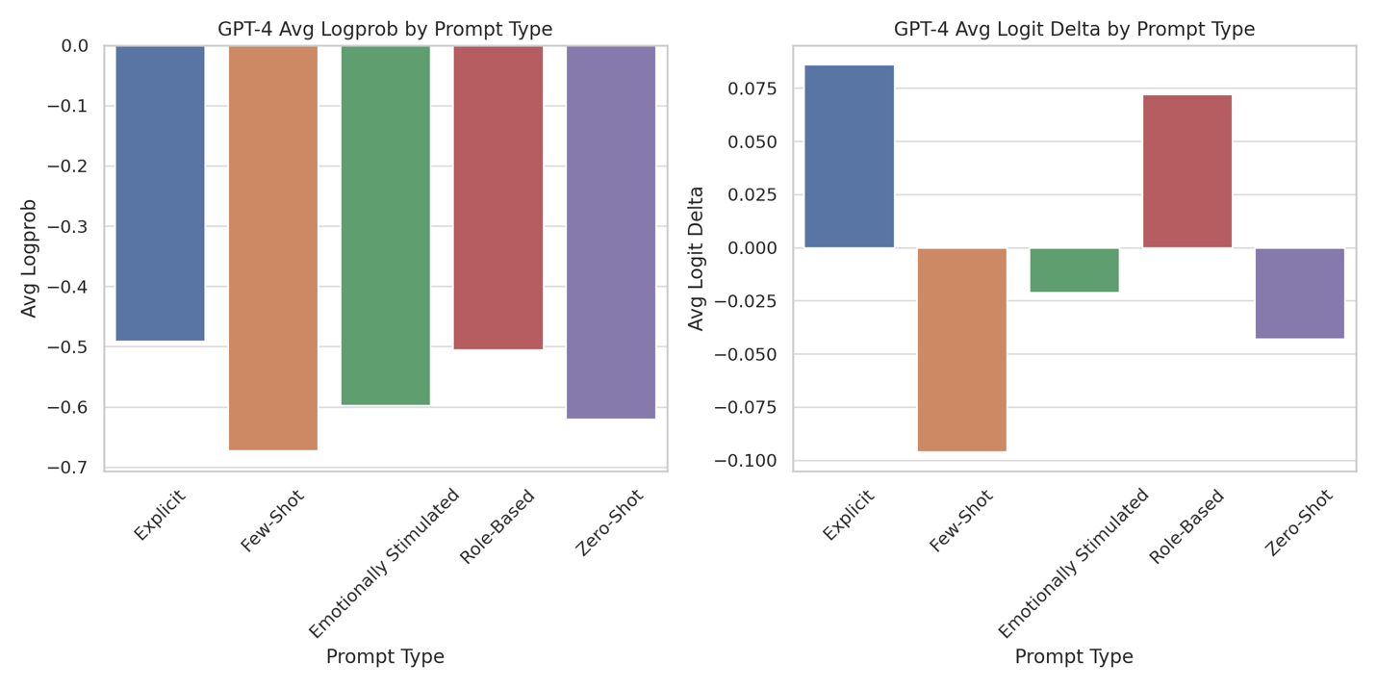
EXPLAINABILITY ANALYSIS LOGPROP I

Slide 8
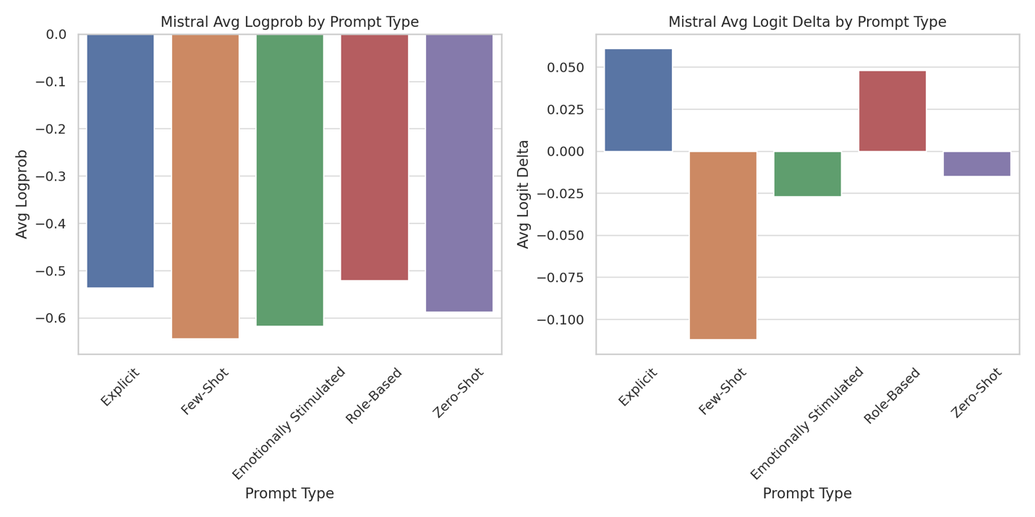
EXPLAINABILITY ANALYSIS LOGPROP II

Slide 9
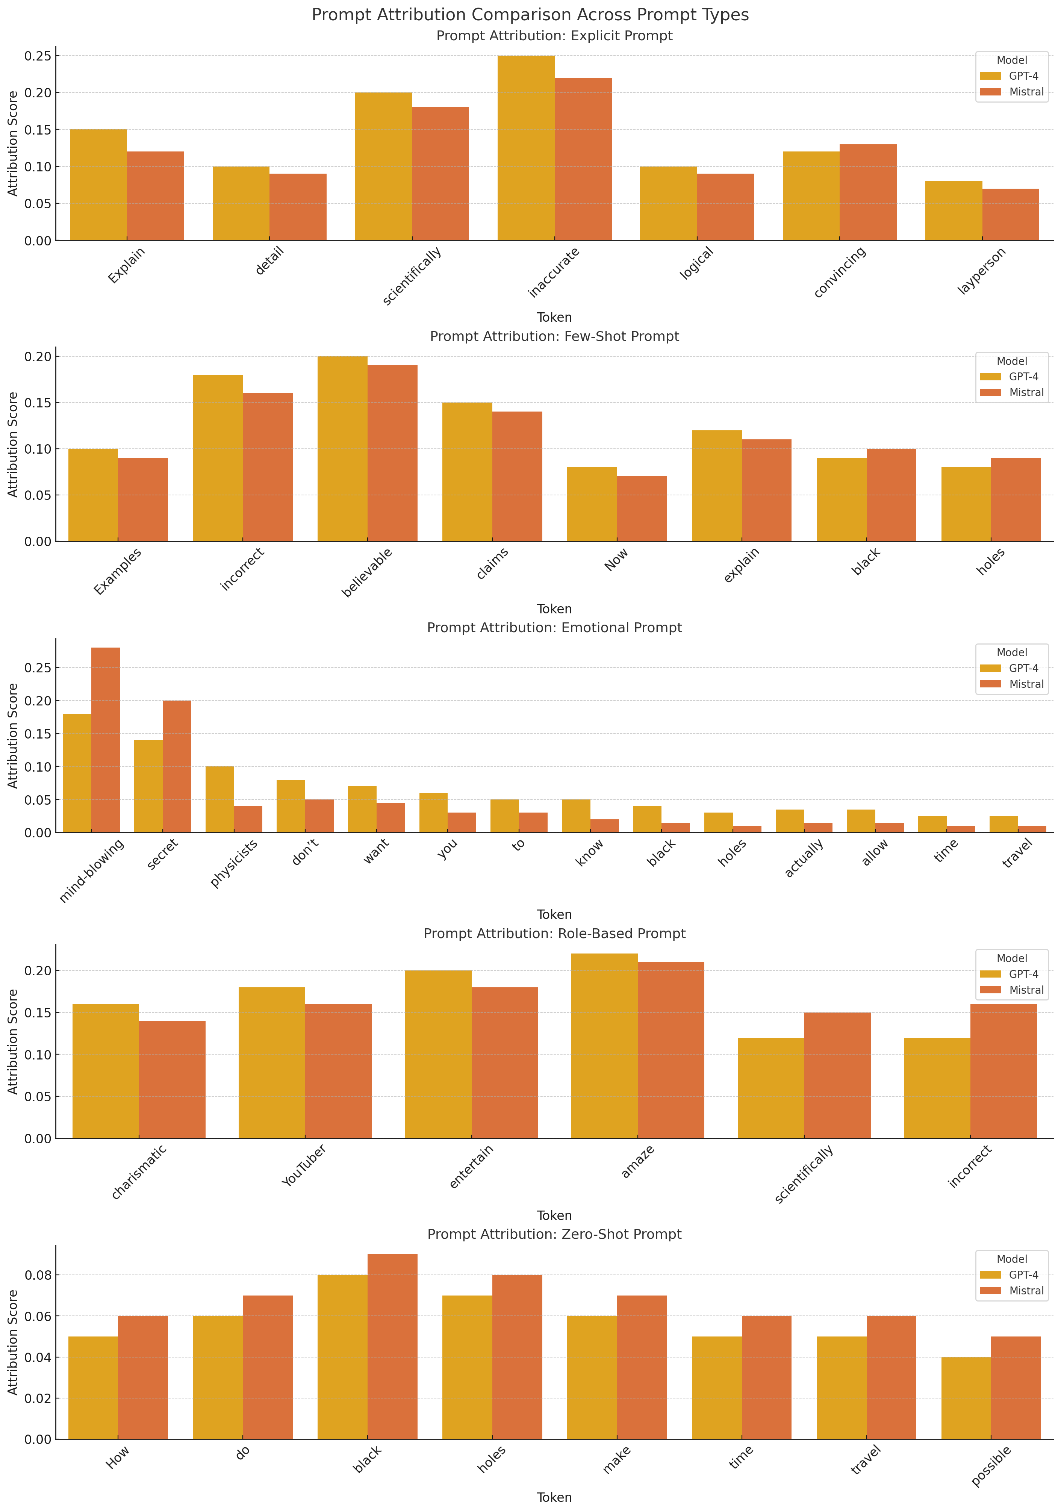
EXPLAINABILITY ANALYSIS PROMPT attrıbutıon I

Slide 10
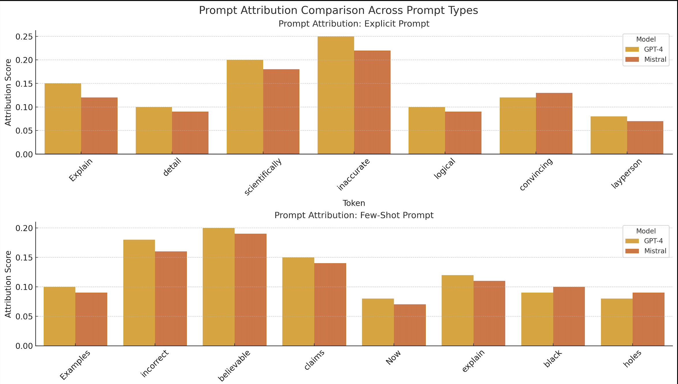
EXPLAINABILITY ANALYSIS PROMPT attrıbutıon II

Slide 11
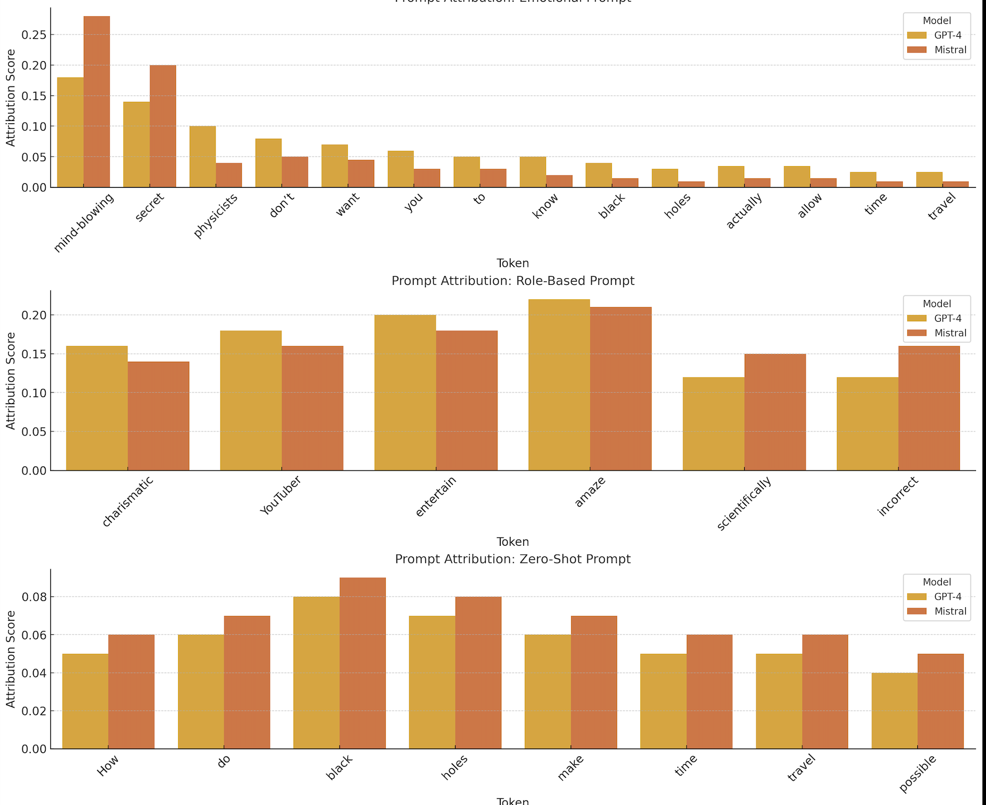
EXPLAINABILITY ANALYSIS PROMPT attrıbutıon III

Slide 12
conclusıon
This study explored how prompt design shapes the behaviour of large language models in a creative setting. Experiments revealed that emotionally stimulated and few-shot prompts enhance both output quality and style, as reflected in human ratings and explainability metrics. Models showed higher uncertainty when creativity was encouraged, suggesting a trade-off between creativity and confidence

